Slide 1
Military Workforce Employment Program (MWEP) May 2019
Provided as part of the San Angelo Workforce Development Committee Initiative

Slide 2



Workforce Development Committee Initiative
Committee Members include representation from:
GAFB (Airman Family Readiness Group,
DoD Skillbridge Program and Public Affairs),
the Chamber of Commerce,
the City of San Angelo Development Corporation,
the Concho Valley Workforce Development Board,
Workforce Solutions but most importantly
Private sector employers from SARMA such as Ethicon, Time Clock Plus
and SITEL

Slide 3
Program Goals
Two main goals exist for this programs:
  Assist Military dependents (spouses and or dependents) obtain jobs and pursue careers within the San Angelo community; and
  Provide internships for transitioning military members under the DoD Skill Bridge Program.
  Note: Training can be provided before and or in conjunction with obtaining employment or participating in an internship.

Slide 4
Introductions
  Course Facilitators Participants
  Randy LeCompte WDB -
  Heather O’Brien WFS
  Ann Barnard WFS
  Allison Garner GAFB
  Jane Mickenheim GAFB
  Brandon O’Neill GAFB
  Others?

Slide 5
Agenda Discussion
Review of participant career objectives
Discussion of Optional Sessions
  Employer Interviews and company tours
  Workforce Solutions Site Tour
  Small Business Development Center presentation
  Lessons Learned from Transitioned Veterans
  ACT Work Keys Testing

Slide 6
ACT Work Keys Test Preparation
Three tests, each 50 minutes in duration, will be administered for total test time of about 3 hours;
For those passing the test, a National Career Readiness Certificate (NCRC) will be provided that can be added to your resume;
Within Tom Green County, currently 142 employers either recognize or recommend the ACT Work Keys test. See link below: https://www.workreadycommunities.org/TX/451

Slide 7
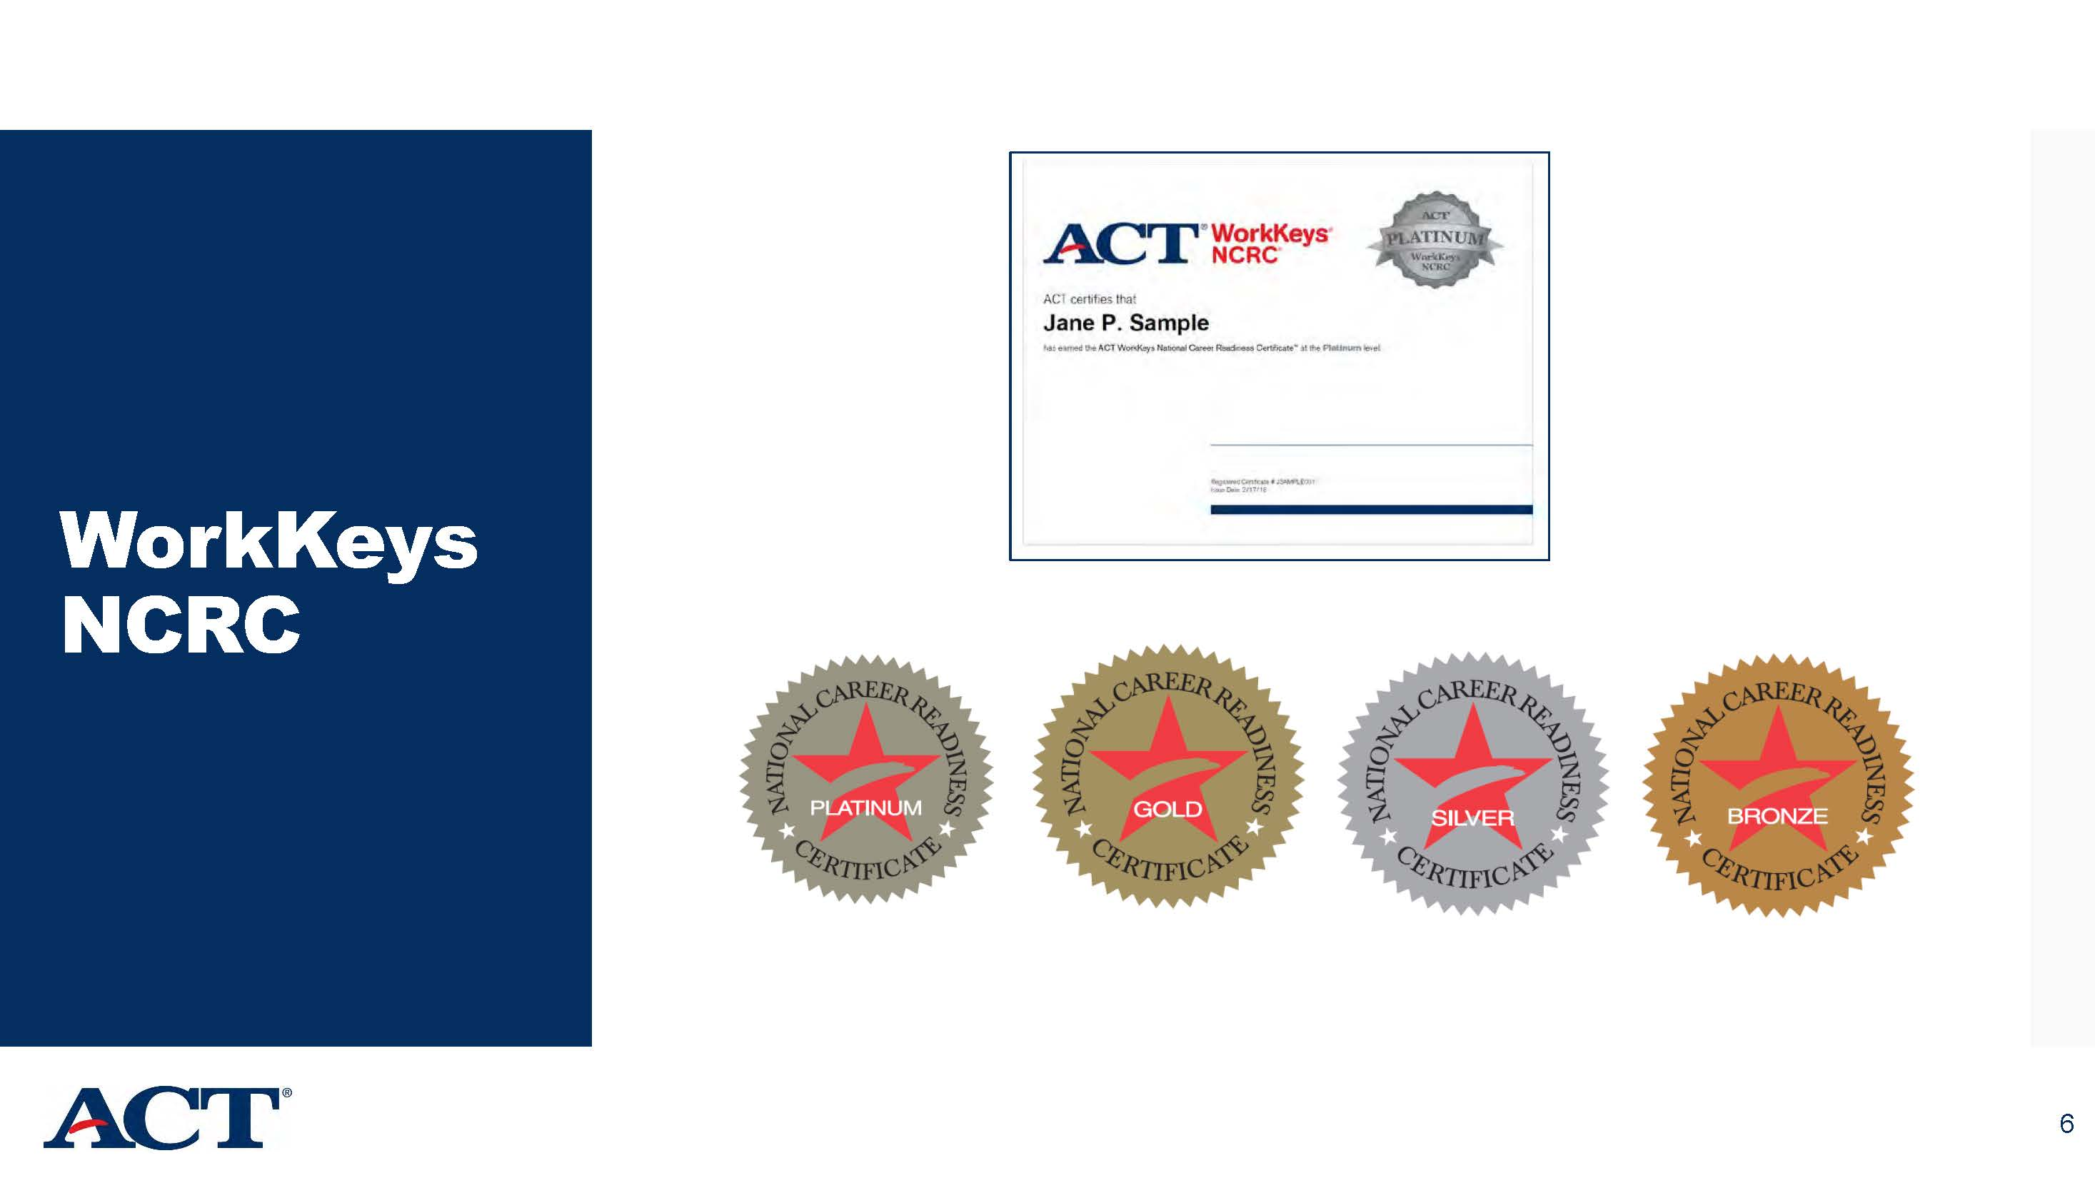
The NCRC

Slide 8
Importance of a Resume
The purpose of a resume is to provide a summary of your skills, abilities and accomplishments. It is a quick advertisement of who you are. It is a "snapshot" of you with the intent of capturing and emphasizing interests and secure you an interview. It is not an autobiography.
First impressions count, and the first impression that a potential employer will have of you, is going to depend on how you present your resume.
The cover letter allows you to target the job and the employer in a very specific way, leaving the resume to market your skills, qualities and experience as a part of the bigger picture. ... You will also need to include the unique skills and the qualities you bring to that job and the company.

Slide 9
Resume Training
Ann Barnard WFS

Slide 10
Employer Company Presentations
SITEL
Time Clock Plus
Others

Slide 11
Employer Breakout Session

Slide 12
Employer Company Presentations
SITEL
Time Clock Plus
Others

Slide 13
Employer Breakout Session

Slide 14
Day 2 Employer Company Presentations
SITEL
Time Clock Plus
Others

Slide 15
Employer Breakout Session

Slide 16
Wrap-Up Discussion
Additional participant resumes?
Second day activities are extremely fluid and could take place at some other date in the future, if desired by both the employer and the participant.
Participants taking place in employer site tours or interviews tomorrow?
NCRC Overview and Scores and Course Feedback – when should this be done given the above?

Slide 17
Additional Activities Available for Tomorrow
Going into Business for yourself / Business Resource Center (BRC) Conference Room (9AM )
Workforce Solutions Site Tour (not related to internship opportunity)
Additional labor market information reports , economic indicators, MOS crosswalk (https://www.onetonline.org/crosswalk/MOC/)
Thoughts/Lessons learned from other military veterans who have transitioned
Educational Opportunities within the Community (e.g. Texas Talent Connection grant)

